Slide 1

Salla Call Center Dataset
By / Merna Ahmed Rageb

Slide 2
Table of contents
01
02
03
04
Introduction
Dataset Information
Dataset Overview
Data Wrangling (Data Cleaning, Data Processing)
Analyzing The Data
Recommendation
Exploratory Data Analysis (EDA)
Enhancing Efficiency & Service Quality

Slide 3
Call Center Performance Analysis – Salla
How does the actual call volume compare to the forecasted calls, and what insights can we gain from the differences?
Which projects have the highest number of abandoned calls and the longest Average Speed of Answer (ASA)?
How can improving forecast accuracy help optimize staffing and enhance service quality?
How does the ratio of Calls Handled to Calls Offered reflect the responsiveness and efficiency of the team?"
How can we evaluate and improve service quality to ensure efficiency and customer satisfaction?
How does the ratio of Calls Handled Within Threshold to Total Calls Handled reflect the overall service quality and efficiency?
How does the abandonment rate impact overall service quality and resource planning
How do key relationships in our data impact performance? A Correlation Analysis

Slide 4
01
Introduction
Dataset Overview

Slide 5
Introduction
This dataset represents call center performance metrics for Salla Call Center in Saudi Arabia. It includes project names, dates, and months, along with key operational indicators such as forecasted calls, actual calls offered and handled calls. Additionally, it tracks service quality metrics like calls handled within the threshold, abandoned calls, average speed of answer (ASA), and answer time. This data provides insights into the efficiency and service level performance of Salla's call center operations.

Slide 6
02
Dataset Information
Data Wrangling (Data Cleaning, Data Processing)

Slide 7
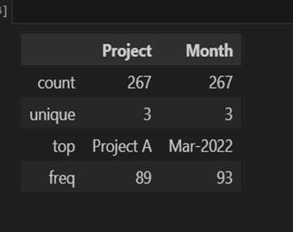
Salla Call Center Dataset
Dataset has 3 Projects A , B, C
Project A 89
Project B 89
Project C 89

Slide 8
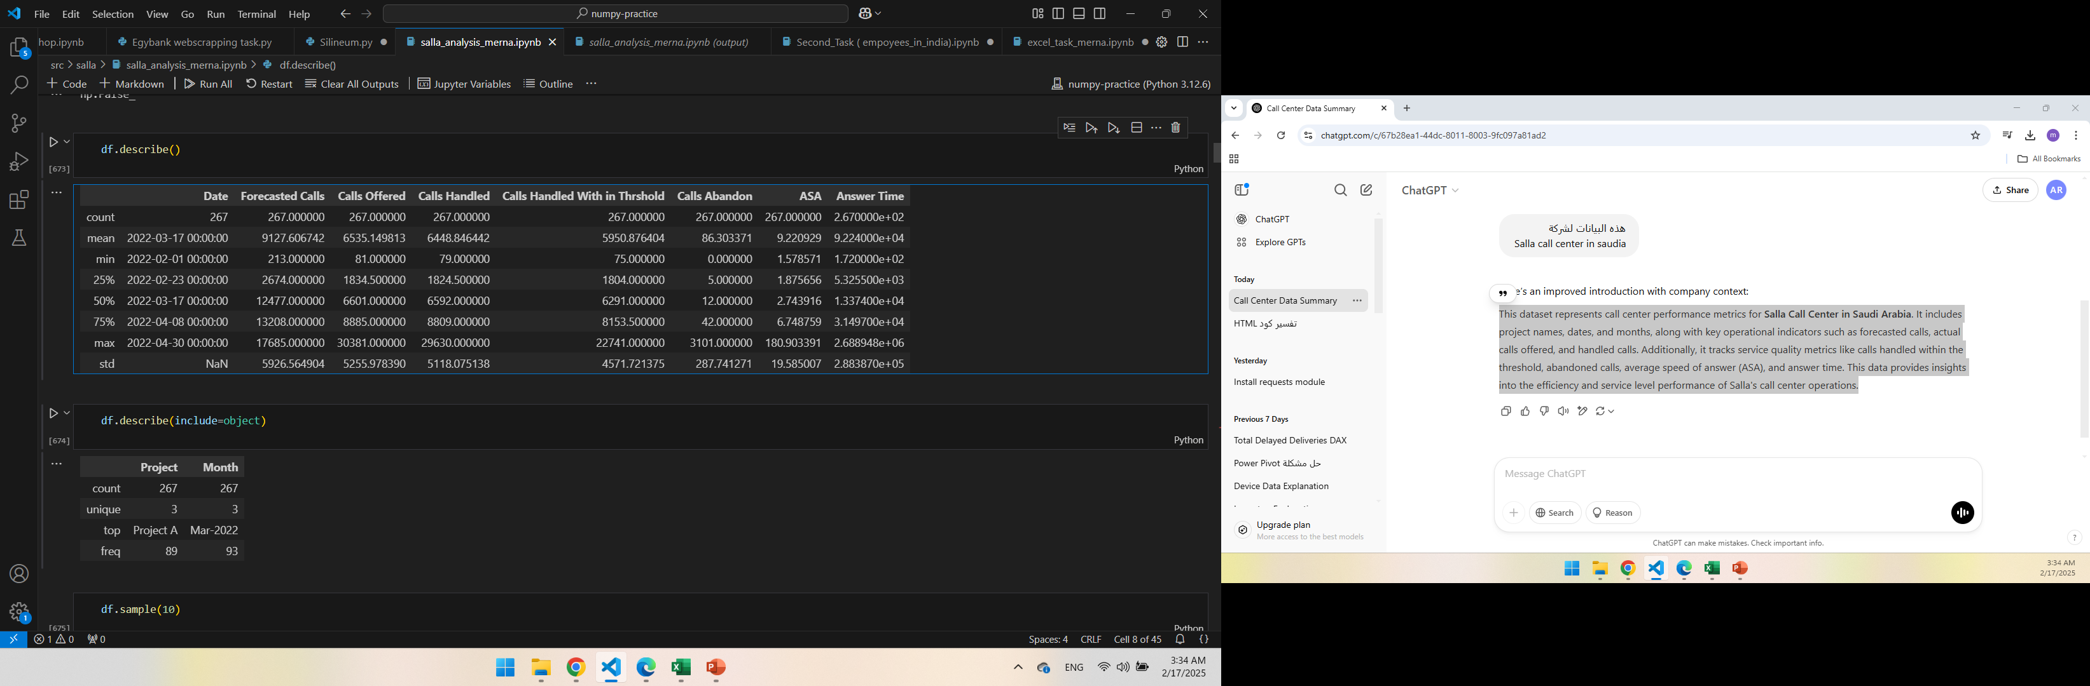
Key Insights from Call Center Performance Data
Forecasted Calls: Ranges from 213 (minimum) to 17685 (maximum), indicating significant variability in the forecasted call volumes over the period.
Calls Offered: Ranges from 81 to 30381, showing that the number of calls offered to the call center can be very high at certain times.
Calls Abandon: Ranges from 0 to 3101, with the highest number of abandoned calls occurring in Project B, which might suggest issues such as inefficiencies, high call volume, or insufficient resources at certain points.
ASA ranges from 1.58 to 180.90, indicating significant variation in the time taken to answer calls. The highest ASA value points to considerable delays in answering calls.
Answer Time ranges from 172 seconds to 2,688,948 seconds, which reflects a wide variation in the time taken to answer calls.
Calls Handled : These values range from 79 (minimum) to 29630 (maximum), reflecting the call center's ability to handle calls successfully and within the allowed time frame.

Slide 9
03
Analyzing The Data
Exploratory Data Analysis (EDA)

Slide 10
Essential Indicators for Performance
Forecast Error = Forecasted Calls - Calls Offered
Mean Absolute Error (MAE) = (1/n) * Σ | Calls Offered – Forecasted Call |
Handling Efficiency = Calls Handled / Calls Offered
Service Level (%) = )Calls Handled With in Threshold / Calls Handled) * 100
Abandonment Rate (%) = )Calls Abandon / Calls Offered) * 100

Slide 11
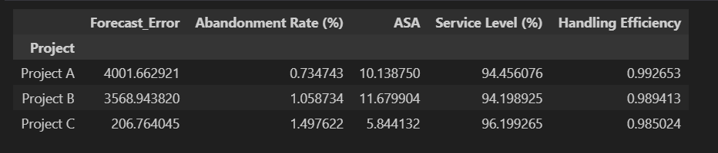
Performance Analysis: Best and Worst Projects Based on Key Indicators
Best Overall: Project C – It performs well in Forecast Error, ASA, and Service Level, but has weaknesses in Abandonment Rate and Handling Efficiency.
Worst Overall: Project B – It performs the worst in ASA and Service Level, and has a relatively high Forecast Error compared to Project C.
Lower is Better : Forecast Error, Abandonment Rate(%), ASA
Higher is Better: Service Level(%) , Handling Efficiency

Slide 12
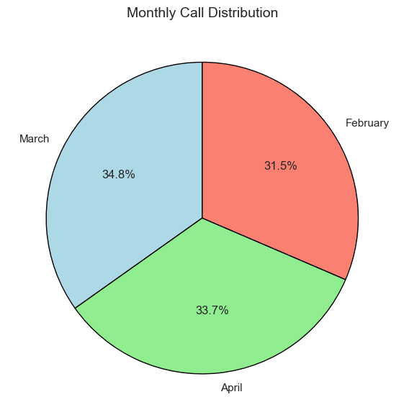
Monthly Call Distribution
March: 93
April: 90
February: 84
March had the highest percentage of calls at 34.83%, followed by April at 33.71%, and finally February at 31.46%.

Slide 13
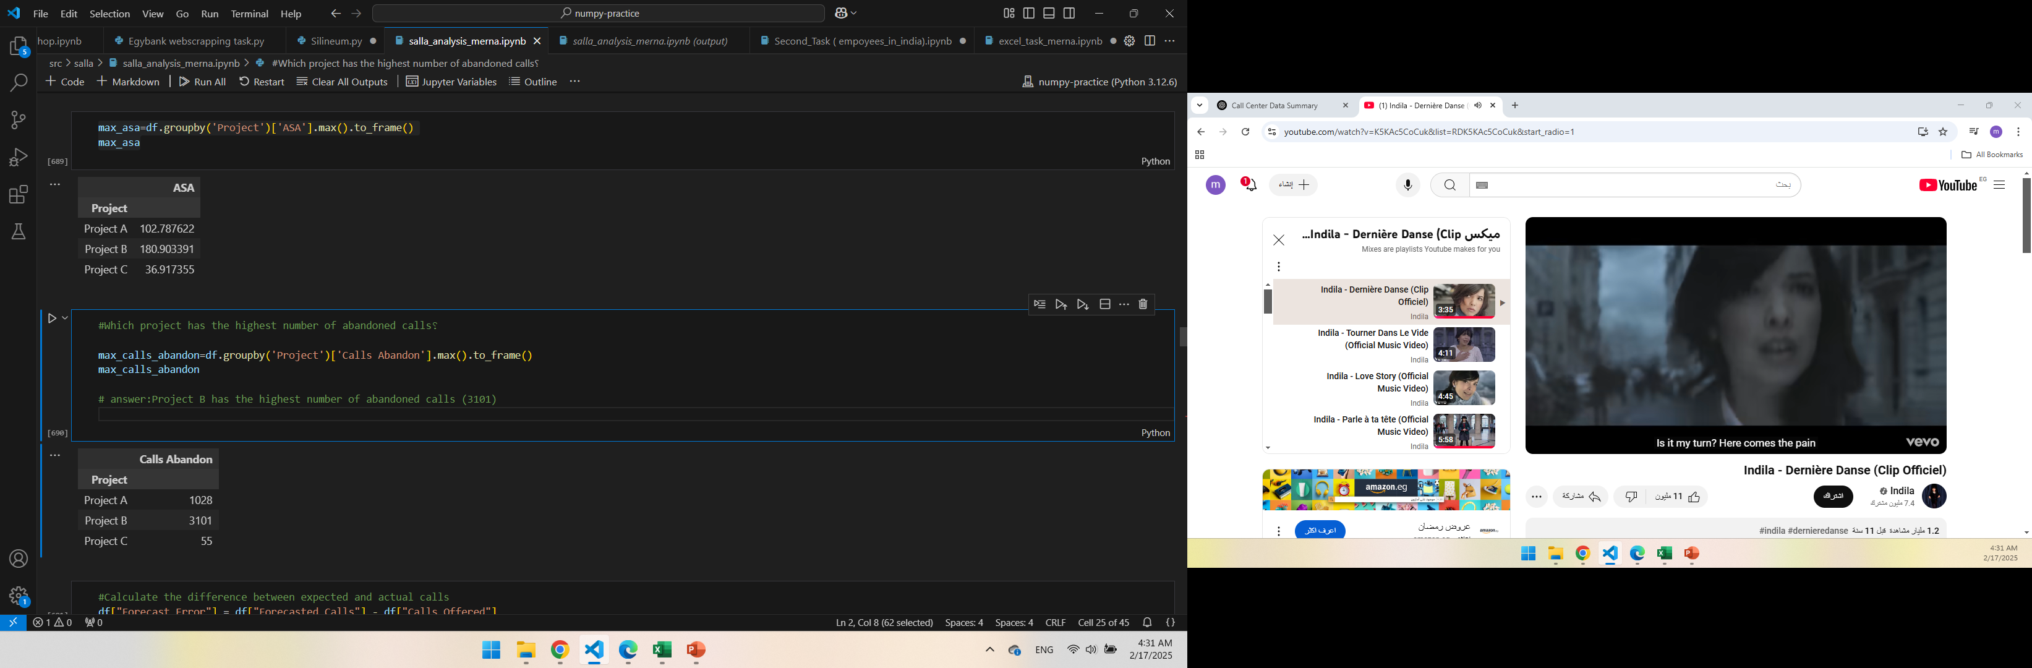
Projects has the highest number of abandoned Calls and ASA
Project B has the highest number of abandoned calls (3101)
This could imply potential issues like inefficiencies, high call volume, or lack of sufficient resources during that period.
Project B has the highest average speed of answer “ASA” (180.90)
This suggests that calls in Project B are being answered more slowly compared to other projects.

Slide 14
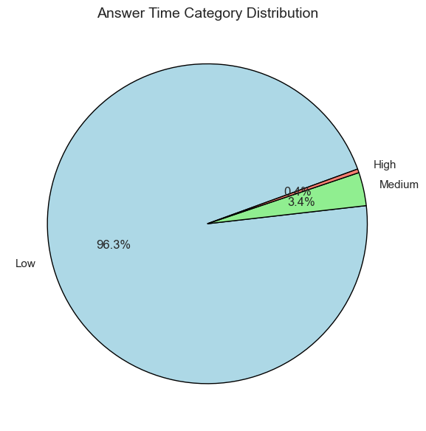
Answer Time Category
Categorized Answer Time Low 257
Medium 9
High 1
The Most Calls were answered promptly, as indicated by the high number of "Low" answer times, with only a few cases falling into the "Medium" and "High" categories, highlighting efficient response times overall.

Slide 15
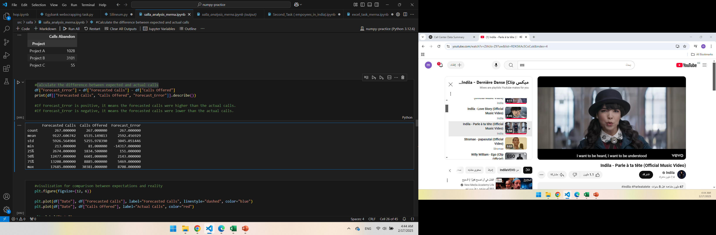
Forecasted vs. Actual Calls: Impact on Forecast Error
Forecast error Max is 8708
Forecast Error Min is -14317
If Forecast Error is positive, it means the forecasted calls were higher than the actual calls.
If Forecast Error is negative, it means the forecasted calls were lower than the actual calls.

Slide 16
Mean Absolute Error (MAE)
Mean Absolute Error (MAE) between Calls Offered and Forecasted Calls is 2991.0936329588017
On Average, the call volume predictions were off by around 2991 calls daily.
The Smaller the MAE, the more Accurate The Forecast.
A High MAE Value like 2991 calls indicates significant forecasting errors, which could lead to:
- Over- or under-staffing, affecting resource allocation.
- Longer wait times and potential service quality issues.

Slide 17
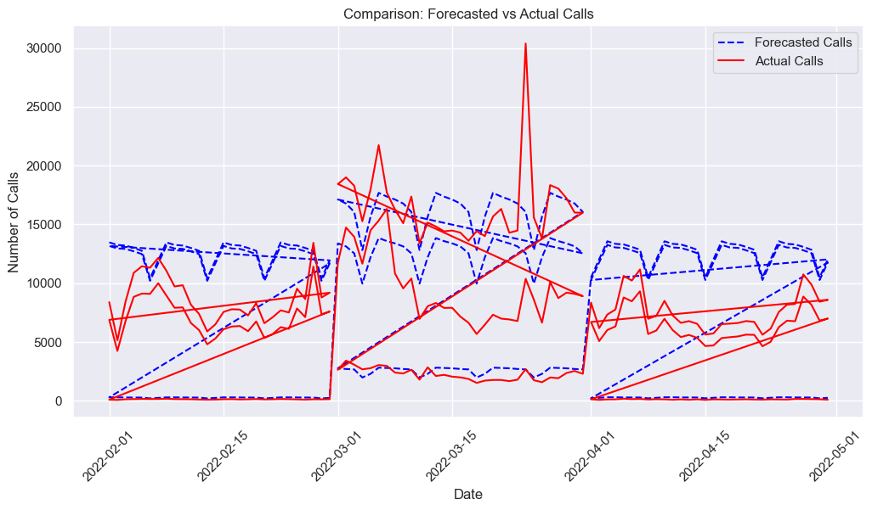
Visualization for comparison between expectations and reality Calls

Slide 18
Fluctuations in Actual Calls:
The red lines show high variability in actual call volumes.
Some days have sharp spikes, particularly around mid-March, indicating unexpected surges in calls.
Forecasting Errors:
The blue dashed lines (forecasted calls) generally follow a pattern but are often higher than actual calls.
Large gaps between the red and blue lines indicate forecasting inaccuracies.
Periods of Major Mismatches:
Around mid-March, actual calls exceed forecasts, suggesting the forecasting model underestimated demand.
In other periods, forecasts are significantly higher than actual calls, meaning overestimation and resource over-allocation.

Slide 19
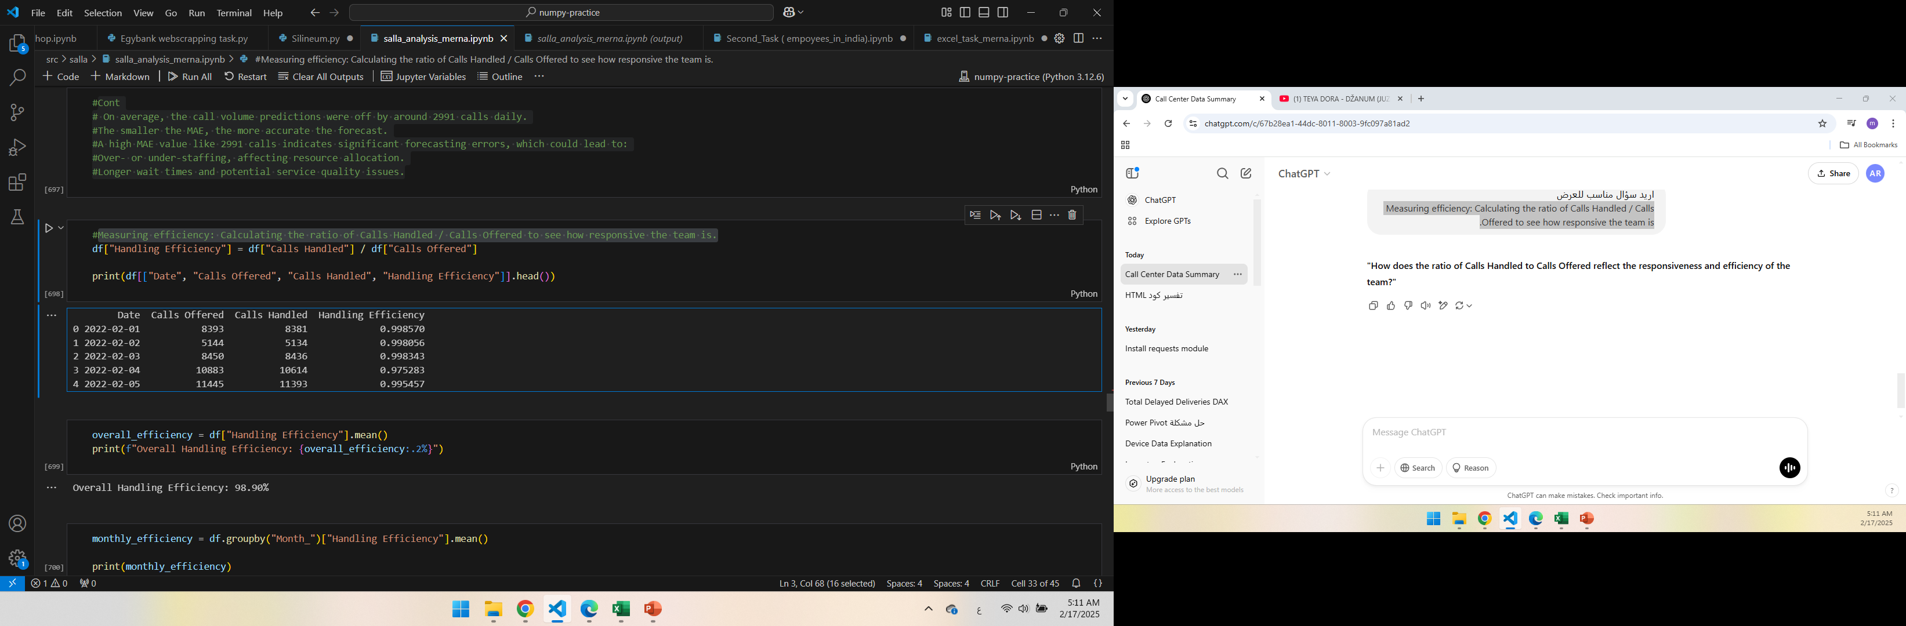

Measuring efficiency: Calculating the ratio of Calls Handled / Calls Offered
Overall Handling Efficiency: 98.90%
Overall, Efficiency is very high (~99%), indicating a well-performing call center
February had the highest efficiency mean (99.29%)
March had the lowest efficiency mean (98.54%),

Slide 20
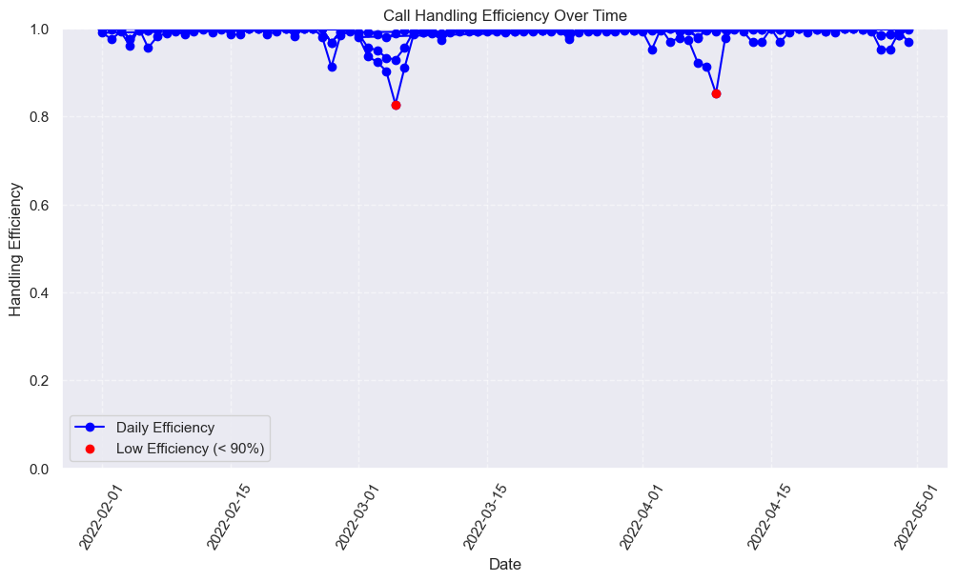
Visualize Performance Over Time

Slide 21
Efficiency Overview
Efficiency values range from 0 to 1:
Above 90% → Excellent performance.
70%-90% → Acceptable, but room for improvement.
Below 70% → Significant issues, need for more staff or process improvements.
Key Insights:
High Efficiency: Most data points are close to 1.0, indicating the call center is handling nearly all calls effectively.
Efficiency Drops: Some dips below 0.9 suggest days when fewer calls were handled, possibly due to high call volume, staff shortages, or longer call times.

Slide 22
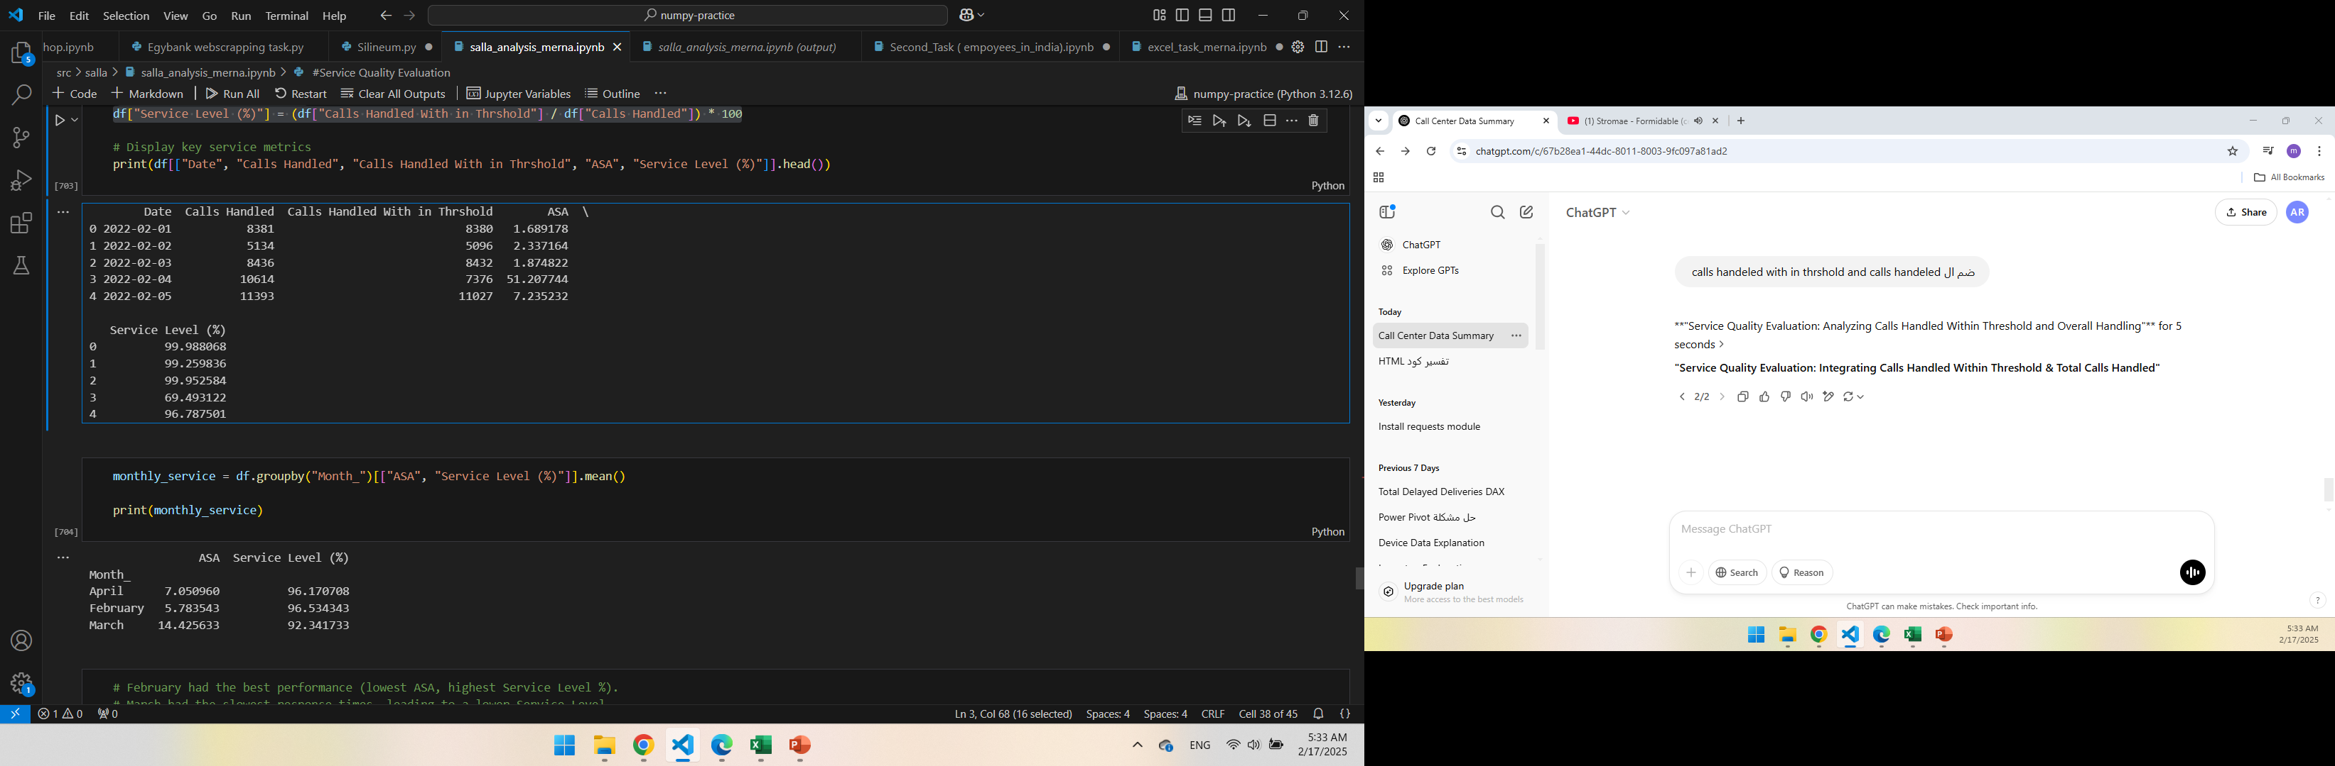
Service Quality Evaluation: Analyzing Calls Handled Within Threshold &Total Calls Handled
February had the best performance (lowest ASA, highest Service Level %).
March had the slowest response times, leading to a lower Service Level.

Slide 23
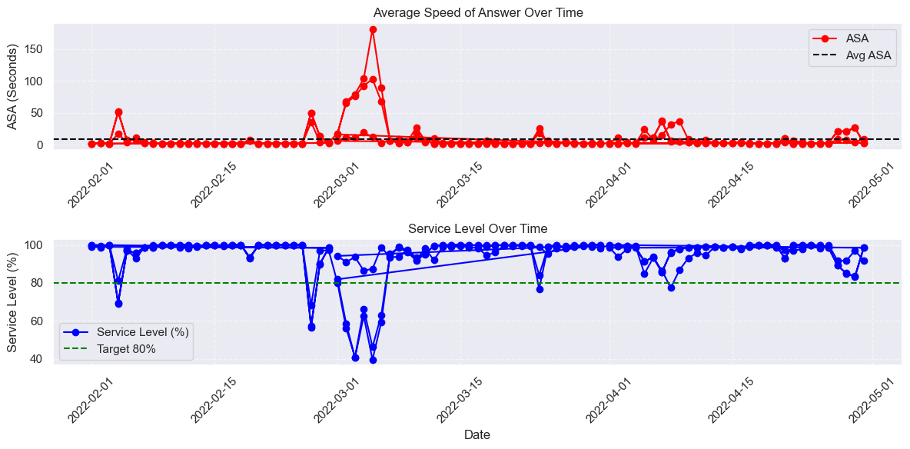
Visualize Service Performance Over Time

Slide 24
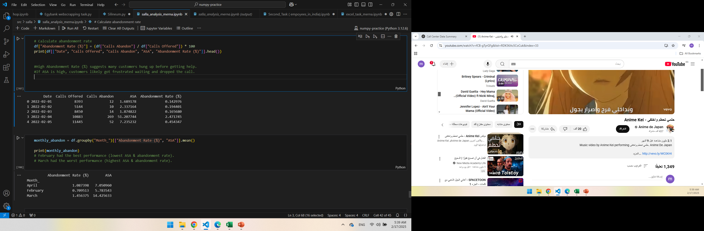
Abandonment Rate Analysis: Assessing the Impact on Service Efficiency
High Abandonment Rate (%) suggests many customers hung up before getting help.
If ASA is high, customers likely got frustrated waiting and dropped the call
February had the best performance (lowest ASA & abandonment rate).
March had the worst performance (highest ASA & abandonment rate).

Slide 25
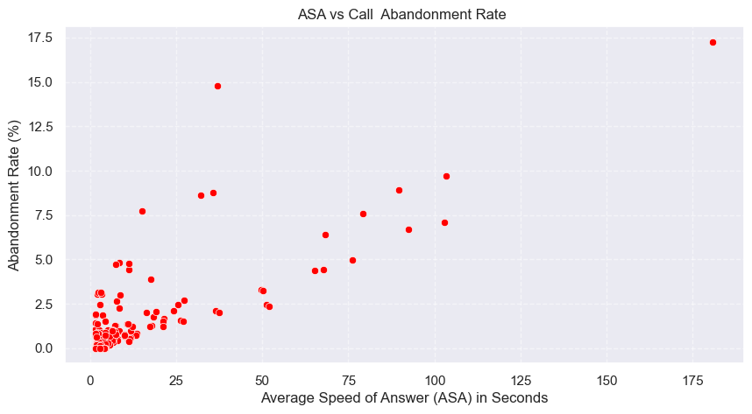
Visualizing the Relationship Between ASA & Abandonment Rate )Scatter Plot)

Slide 26
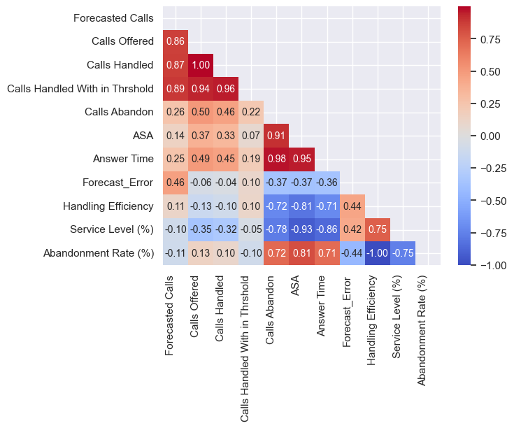
Understanding Key Relationships: Correlation Analysis for Performance Insights

Slide 27
Strong Positive Correlations:
Calls Offered & Calls Handled (0.99): Almost all offered calls are handled, indicating good capacity management.
Calls Handled & Calls Handled Within Threshold (0.96): A high percentage of handled calls meet the threshold, showing strong operational efficiency.
Calls Abandon & ASA (0.91): The longer the Average Speed of Answer (ASA), the higher the abandonment rate, suggesting that delayed responses lead to more callers hanging up.
Calls Abandon & Answer Time (0.98): A longer Answer Time also strongly correlates with more abandoned calls, reinforcing the need for faster response times.
Strong Negative Correlations:
Handling Efficiency & Abandonment Rate (-1.00): As handling efficiency improves, the abandonment rate drops, reinforcing the importance of quick and effective call handling.
Service Level & ASA (-0.93): Longer Average Speed of Answer (ASA) lowers service levels, indicating that faster response times improve overall service quality.
Service Level & Answer Time (-0.86): A longer Answer Time also negatively impacts service levels, suggesting that delays in handling calls lead to a decline in performance.
Calls Abandon & Service Level (-0.78): More abandoned calls reduce overall service quality, emphasizing the impact of missed calls.

Slide 28
04
Recommedation
Enhancing Efficiency & Service Quality

Slide 29
Recommendation
March recorded the highest ASA (Average Speed of Answer), particularly during the first 15 days. -To address this, we are considering increasing the number of staff during this period. Additionally, we could explore optimizing shift schedules, implementing real-time monitoring to quickly address spikes in demand, or enhancing automated responses to manage simple inquiries more efficiently . -Reducing ASA and answer time will improve service levels and reduce call abandonment. Streamlining workflows and providing targeted training for the team can also boost overall efficiency."
To enhance Project B's performance, we recommend focusing on reducing ASA and improving Service Level by increasing staff availability during peak hours, optimizing scheduling, and leveraging real-time monitoring to address delays promptly.
Enhancing Forecast Accuracy and Adaptability
The forecasting model needs improvement to reduce overestimation and underestimation errors.
Use historical data and advanced forecasting techniques to improve the accuracy of call volume predictions and reduce forecast errors.
Further analysis of seasonality, trends, and external factors could improve forecast accuracy
Additionally, minimizing Forecast Error can be achieved through more accurate demand forecasting models and regular data analysis.

Slide 30
Cont. Recommendation
Key Drivers of High Efficiency
Optimize Staffing Levels: Ensure that staffing is aligned with call volume predictions to prevent overstaffing or understaffing, which can lead to inefficiencies.
Streamline Call Handling: Focus on reducing call handling time while maintaining quality, ensuring agents resolve issues effectively without delays.
Monitor and Address Efficiency Drops: Investigate days with lower efficiency and identify underlying causes (e.g., peak hours, staff shortages) to address these issues proactively.

Slide 31

Thank you for your attention

